Slide 1

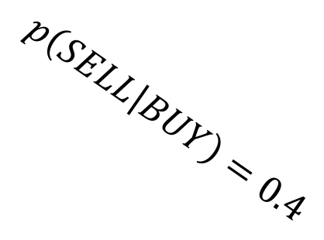

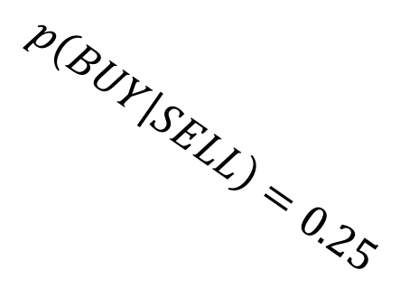
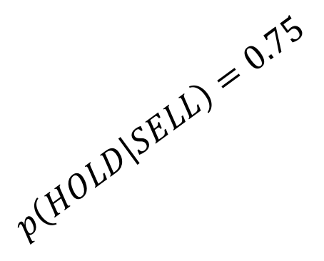
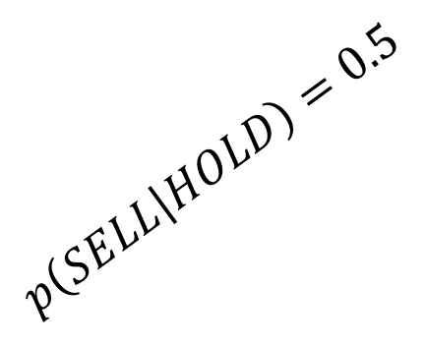
$$p\left(HOLD | BUY\right)=0.6$$
BUY
HOLD
r = 1
$$p\left(BUY | HOLD\right)=0.5$$
r = 0
$$p\left(SELL | HOLD\right)=0.5$$
$$p\left(BUY | SELL\right)=0.25$$
$$p\left(SELL | BUY\right)=0.4$$
$$p\left(HOLD | SELL\right)=0.75$$
SELL
r = -1

